Slide 1

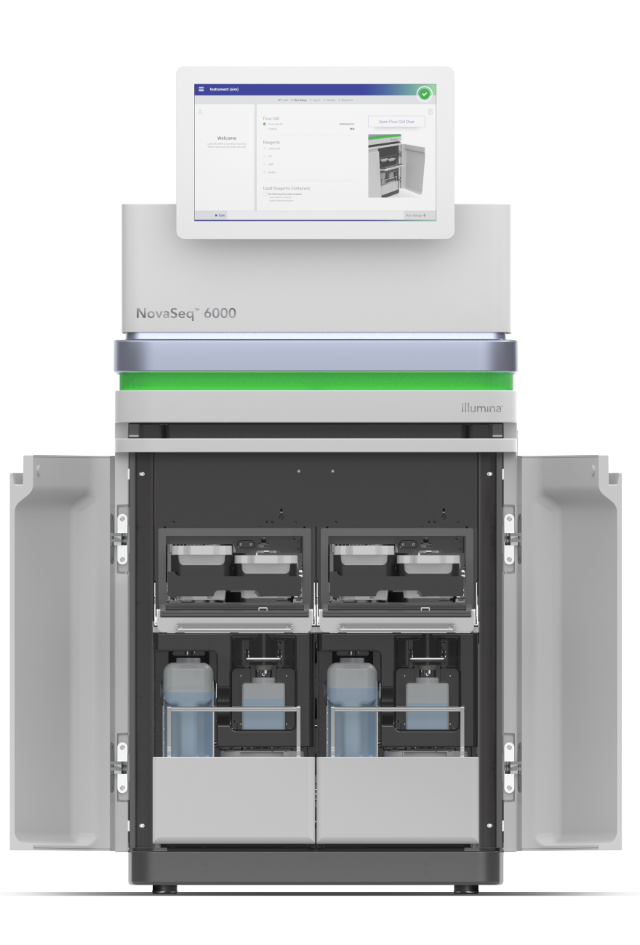
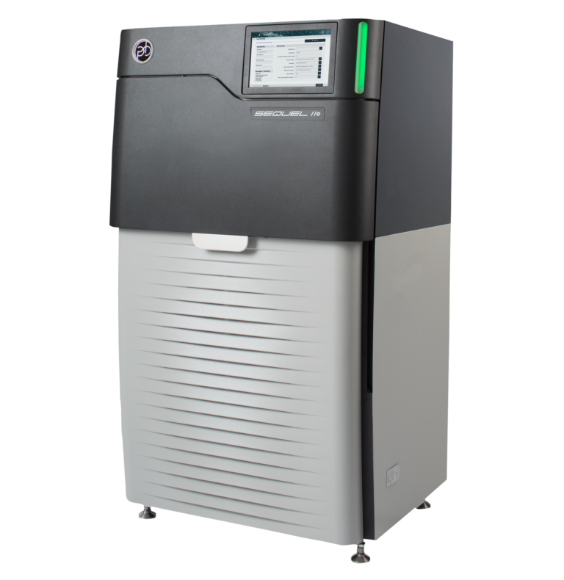

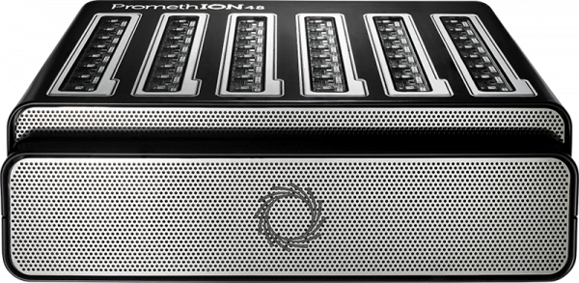

Typical Genomics
Obtaining Genomic Data
Genomic Analyses
DNA extraction and
Library preparation
Sequencing and basecalling
Accessing genomic databases
Sparsified Genomics
Obtaining
Genomic
Data
Sparsifying
Input genomic data
Smaller, sparsified data
Sparsified
Genomic Analyses
1
Compressed Indexing
2
Pattern Alignment
3
Compressed Seeding
.FASTA/.FNA
.FASTQ
.FASTQ
Reference genome
Read
Read
Read
Diet pattern
Diet pattern 0
Diet pattern 1
Alignment index
1010101010101010101010
1010101010
1010101010
Diet pattern
Patterned genome
Patterned read 0
Patterned read 1
1010101010
Seeds
Patterned read
Minimizer seed index
Counting occurrences in the index
Seeds
Seed
hash
Seed locations
1 occurrence
92 occurrences
3, 15, 25
5, 19, 23
3, 15, 25
5, 19, 23
Alignment index = 1
Locations of matching seeds in the original reference genome
4
Location Voting
5
Sequence Alignment
Sorted location list
Genome
Subsequence at location 15
Read sequence
3, 5, 15, 19, 23, 25,
✕
✕
✓
✓
✓
✓
.SAM/.BAM
Dynamic
programming
matrix
15 is a potential mapping location

Slide 2
1
Compressed Indexing
2
Pattern Alignment
.FASTA/.FNA
.FASTQ
Reference genome
Read
Read
Diet pattern
Diet pattern 0
Diet pattern 1
1010101010101010101010
1010101010
1010101010
Patterned genome
Patterned read 0
Patterned read 1
Seeds
Counting occurrences in the index
Minimizer seed index
1 occurrence
Seed
hash
Seed locations
92 occurrences
3, 15, 25
5, 19, 23
Alignment index = 1
3
Compressed Seeding
4
Location Voting
.FASTQ
Sorted location list
3, 5, 15, 19, 23, 25,
Read
✕
✕
✓
✓
✓
✓
Alignment index
15 is a potential mapping location
Diet pattern
1010101010
Patterned read
5
Sequence Alignment
Seeds
Read sequence
3, 15, 25
5, 19, 23
Genome
Subsequence at location 15
.SAM/.BAM
Locations of matching seeds in the original reference genome
Dynamic programming matrix

Slide 3
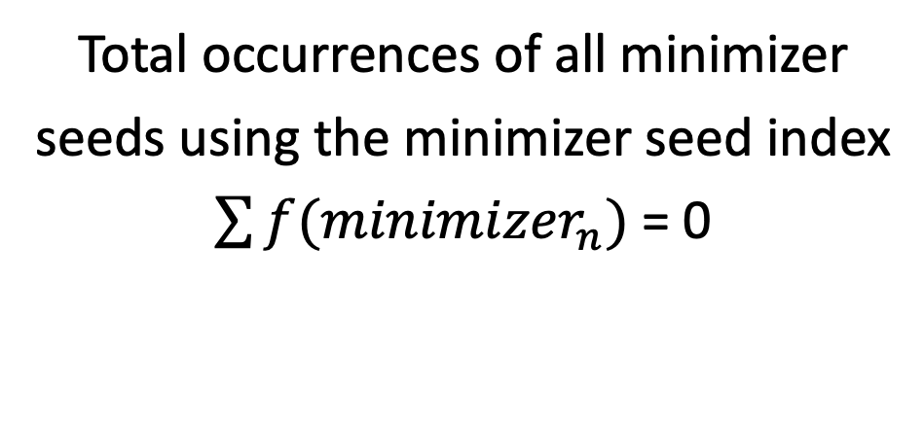
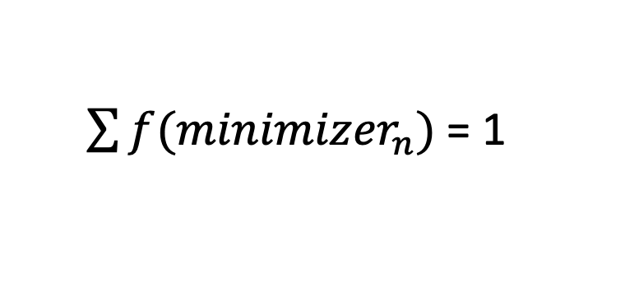
Compressed Indexing of Reference Genome
Genome sequence:
1 | 2 | 3 | 4 | 5 | 6 | 7 | 8 | 9 | 10 | 11 | 12 | 13 | 14
A | C | C | C | T | A | G | C | C | C | T | A | A | G
Diet pattern:
1 | 0 | 1 | 0 | 1 | 0 | 1 | 0 | 1 | 0 | 1 | 0 | 1 | 0
1 | 3 | 5 | 7 | 9 | 11 | 13
Minimizer seed index
Patterned genome:
A | C | T | G | C | T | A
H(ACTG)= 4
Seed
hash
Seed locations
A | C | T | G
✕
H(CTGC)= 1
k-mers:
 | C | T | G | C
✓
3
5
 |  | T | G | C | T
H(TGCT)= 2
✓
A
 |  |  | G | C | T | A
H(GCTA)= 3
✕
Read sequence:
G | A | C | C | C | T | A | G | C | C | C | T | A | A
Inferring Pattern Alignment Index for Each Read
Diet pattern 0:
1 | 0 | 1 | 0 | 1 | 0 | 1 | 0 | 1 | 0 | 1 | 0 | 1 | 0
Patterned read 0:
G | C | C | A | C | C | A
Total occurrences of all minimizer seeds using the minimizer seed index
$\sum{f({minimizer}_{n})}$= 0
H(GCCA)= 8
k-mers:
G | C | C | A
✕
✕
 | C | C | A | C
H(CCAC)= 6
✓
Read sequence:
G | A | C | C | C | T | A | G | C | C | C | T | A | A
Diet pattern 1:
Shift amount = 1
 | 1 | 0 | 1 | 0 | 1 | 0 | 1 | 0 | 1 | 0 | 1 | 0 | 1 | 0
Patterned read 1:
 | A | C | T | G | C | T | A
Alignment index = shift amount = 1
 |  | A | C | T | G
H(ACTG)= 4
✕
$\sum{f({minimizer}_{n})}$= 1
k-mers:
 |  |  | C | T | G | C
H(CTGC)= 1
✓
B
✓
Read sequence:
G | A | C | C | C | T | A | G | C | C | C | T | A | A
Diet pattern:
Alignment index = 1
 | 1 | 0 | 1 | 0 | 1 | 0 | 1 | 0 | 1 | 0 | 1 | 0 | 1 | 0
Compressed Seeding of Read Sequence
Patterned read:
A | C | T | G | C | T | A
H(TCTG)= 4
These minimizer seeds are used as query seeds for finding potential mapping locations of a read in the reference genome
T | C | T | G
✕
H(CTGC)= 1
k-mers:
 | C | T | G | C
✓
 |  | T | G | C | T
H(TGCT)= 2
✓
C
 |  |  | G | C | T | A
H(GCTA)= 3
✕
Genome sequence:
32437
3004
7832
10020
15000
31303
✕
Chr 1:
Chr 2:
Δ1 = 3004 – 8
Δ2 = 7832 - 4933 |Δ2 - Δ1| = 97 < D
Δ1 = 10020 – 7
Δ2 = 15000 - 4933 |Δ2 - Δ1| = 54 < D
Δ1 = 31303 – 6039
Δ2 = 32437 - 7201 |Δ2 - Δ1| = 28 < D
Location Voting
7201
Read sequence:
8
4933
6039
Primary
D
Secondary
Supplementary

Slide 4
A
B
C
Execution time (sec)
D
E
F
6.64x
3.38x
56.4x
1.66x
2.1x
199.6x
10.62x
2.62x
401.6x
Execution time (sec)
1.63x
1.62x
1.68x
G
H
I
J
Chromosome 1
K
Chromosome 1
L
Chromosome 1
2,070
255
12,995
300
605
837
1,627
1,729
8,986
696
888
5,324
2,310
1,860
12,112
Illumina - Indels
HiFi - Indels
HiFi - SVs
ONT - Indels
ONT - SVs
1756
479
11,438
371
4,929
691
3,777
11,934
6,304
4,434
6,283
5,529
7,489
9,988
17,117
Human Genome
Human Genome
minimap2
Genome-on-Diet
Human Genome
A
B
C
Memory footprint (GB)
Memory footprint (GB)
Memory footprint (GB)
A
B
Execution time (sec)
2.59x
2.59x
Index size (GB)
2.74x
2.52x
3.11x
2.86x
2.79x
2.79x
C
D
Avg. seed matches / read
Peak memory (GB)
2.4x
2.04x
1.89x
1.88x

